Slide 1





AIRHUB: FLIGHT BOOKING SYSTEM
Group 8
Arnav V., Vaishnavi C. , Mittul S., Riya S., Monisha M.

Slide 2


overview
The objective of our project is to develop a comprehensive database management system for an Airplane Booking System
Problem Statement:
Current systems lack sophistication, causing inefficiencies
Inadequate security risks breaches and disruptions
Goals:
Optimize operations for enhanced satisfaction
Establish secure, reliable infrastructure
Design consideration:
Data normalization for efficient storage and retrieval
Scalable architecture to accommodate growth

Slide 3
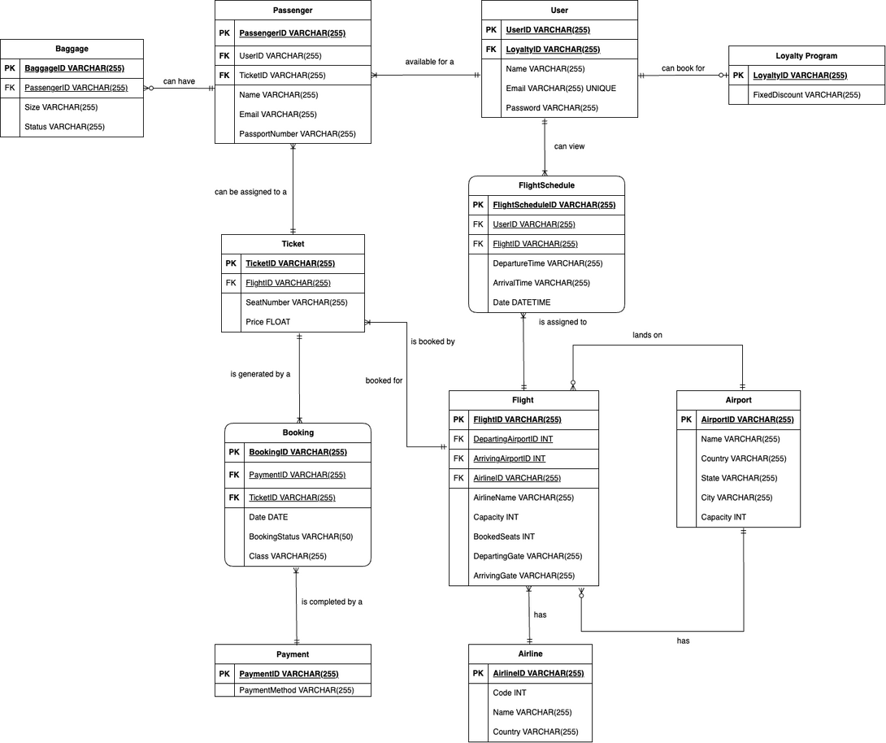
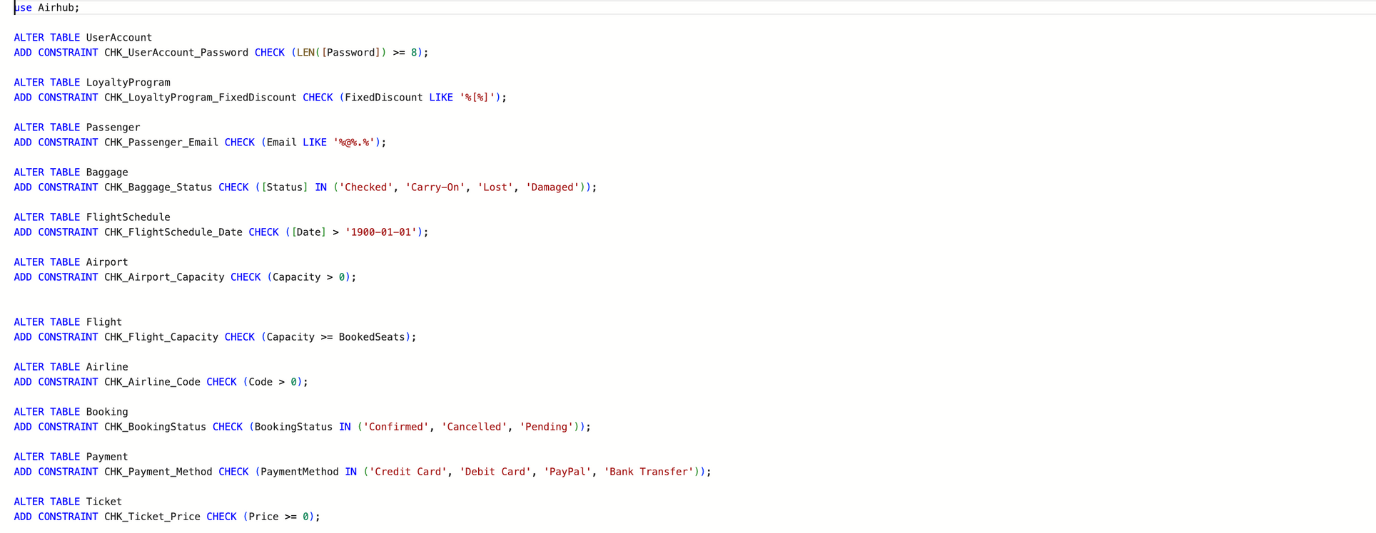
FINAL ERD
DDL CHECK CONSTRAINTS

Slide 4
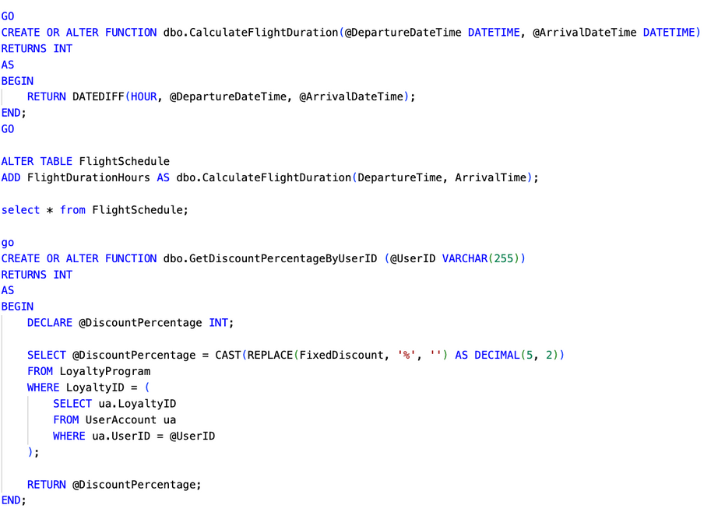
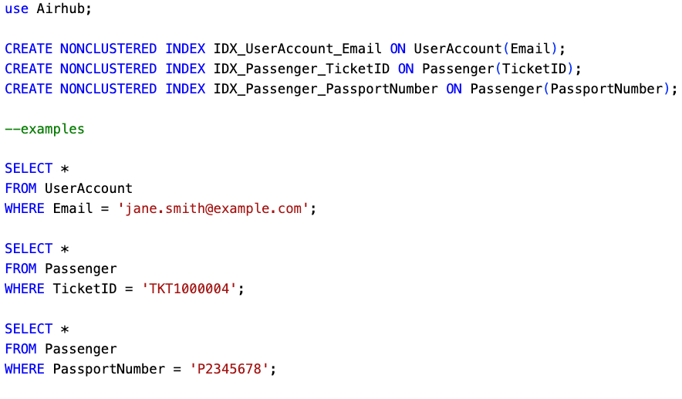
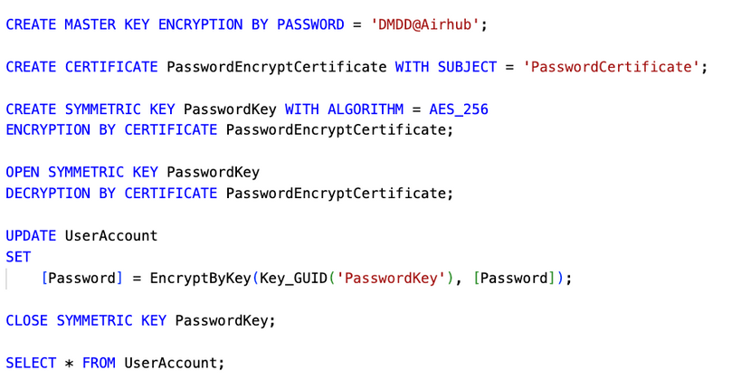
UDF & COLUMN DATA ENCRYPTION
NON-CLUSTERED INDEXES

Slide 5

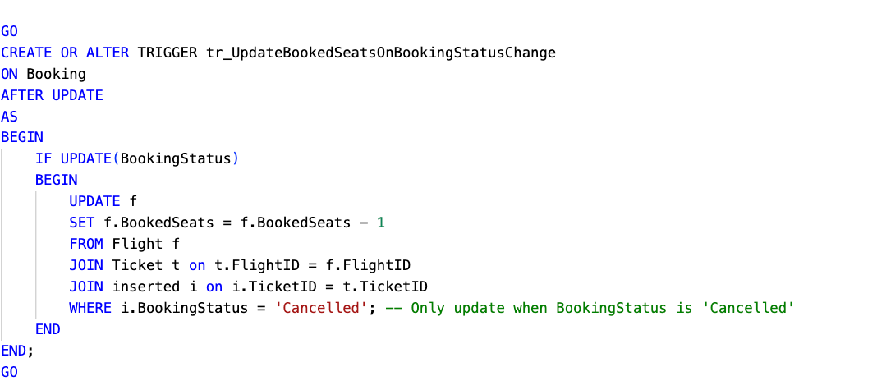
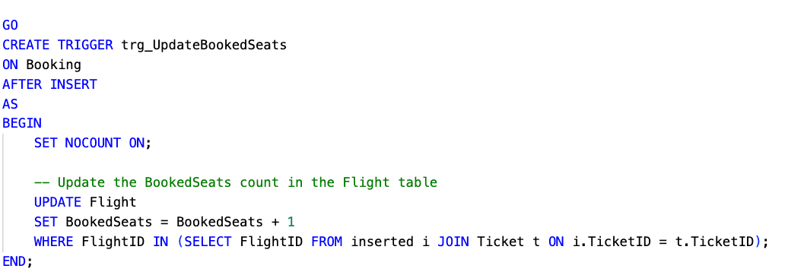
TRIGGERS

Slide 6
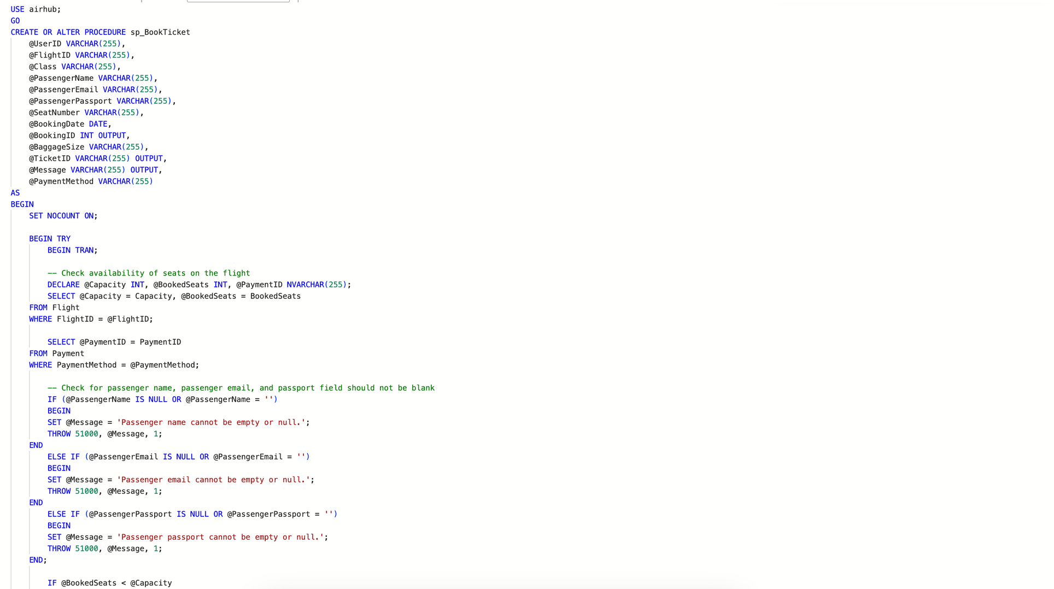
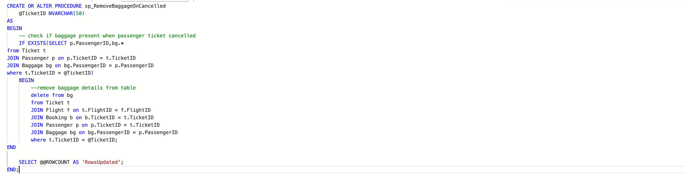
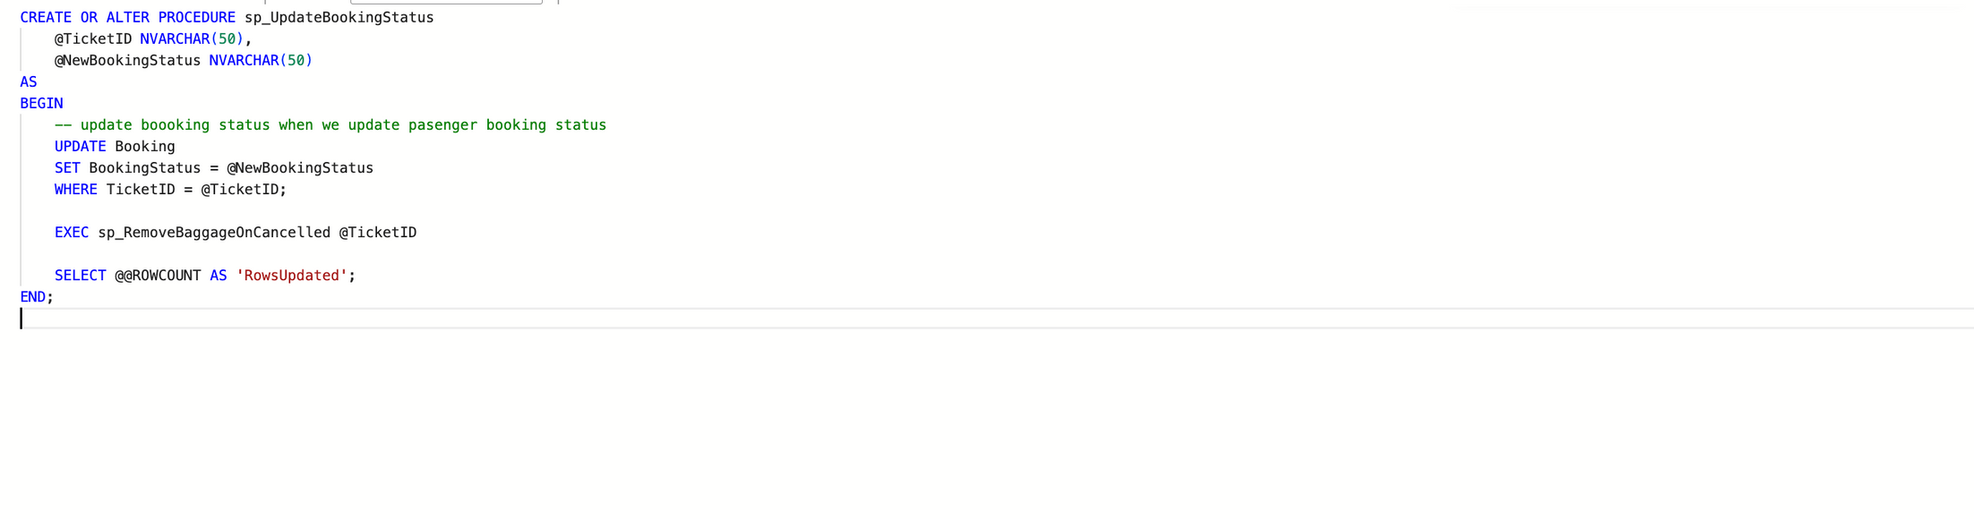
STORED PROCEDURES
SP_BOOKTICKET
SP_REMOVEBAGGAGEONCANCELLED
SP_UPDATEBOOKINGSTATUS

Slide 7
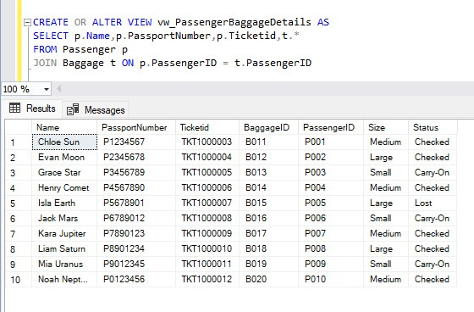
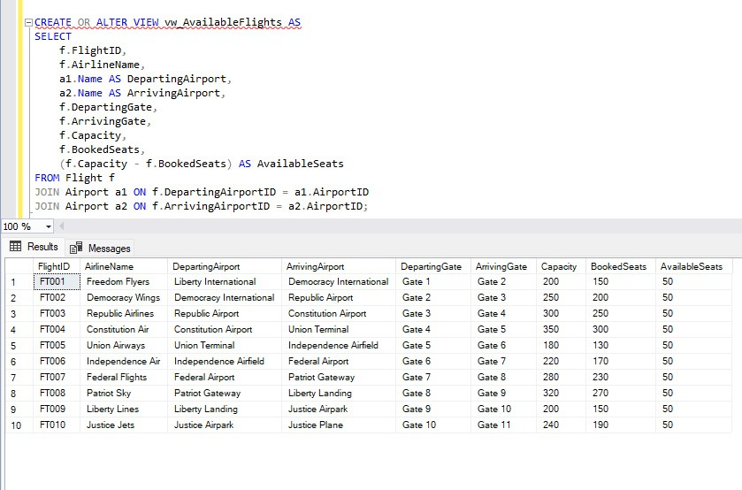
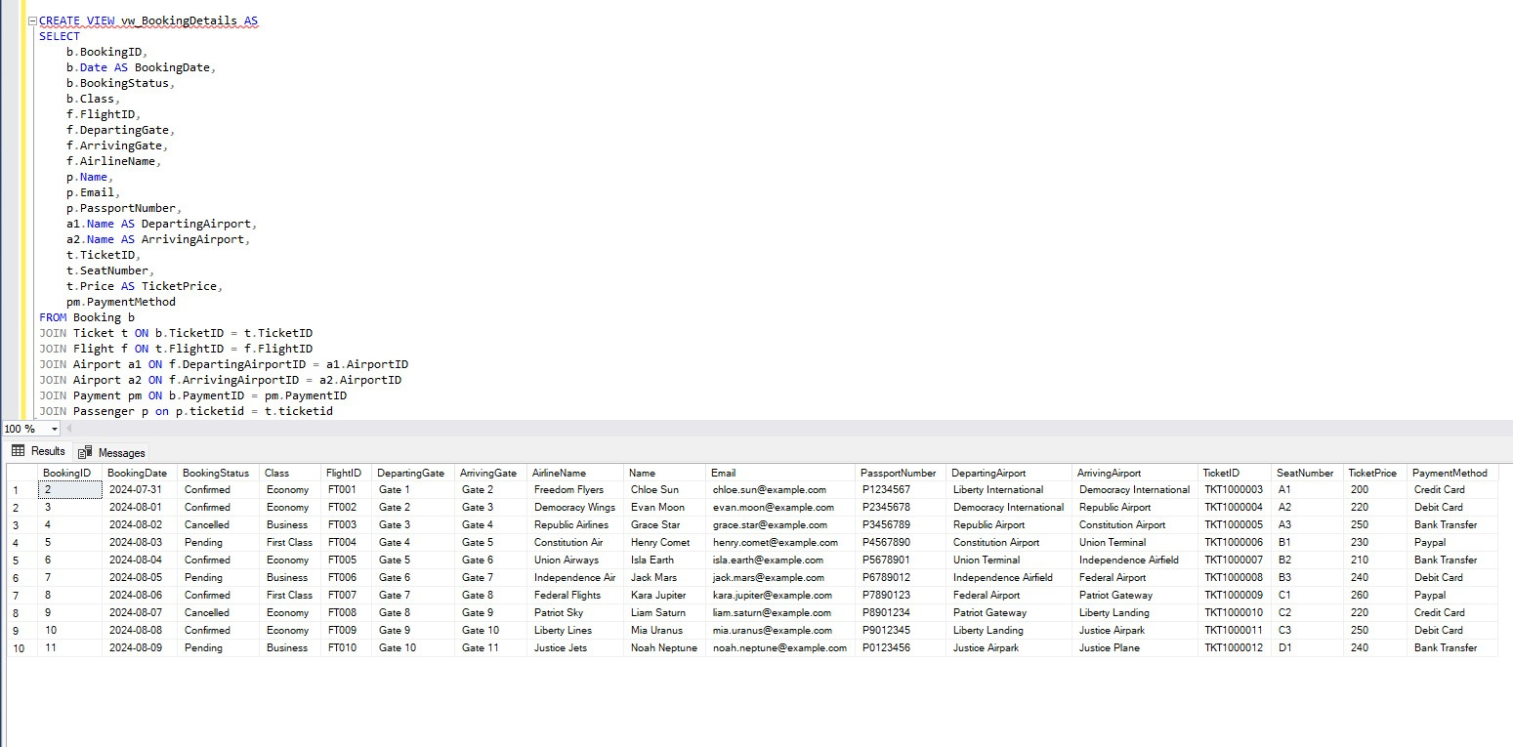
VIEWS
PASSENGER BAGGAGE TRACKING
FLIGHT AVAILABILITY
PASSENGER BOOKING

Slide 8
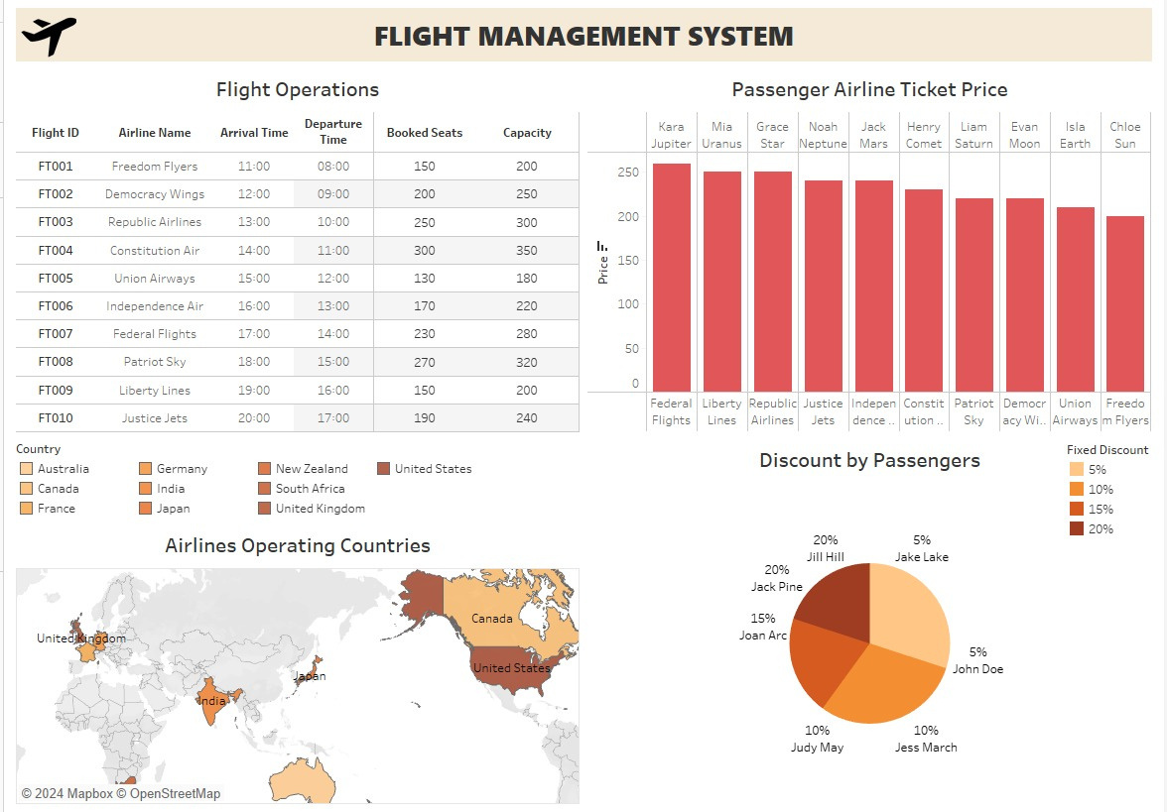
TABLEU DASHBOARD

Slide 9
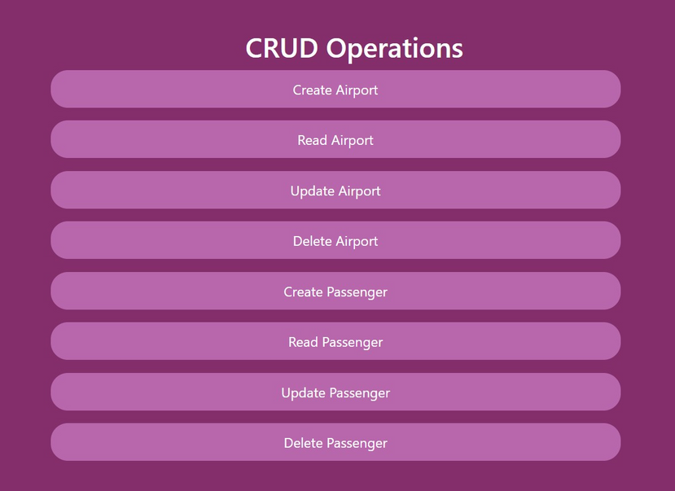
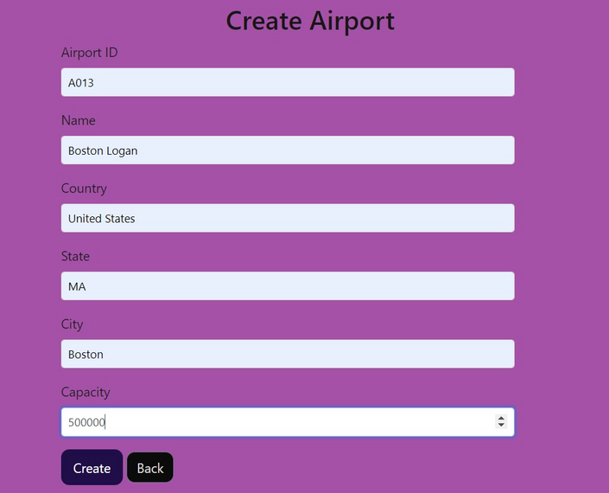

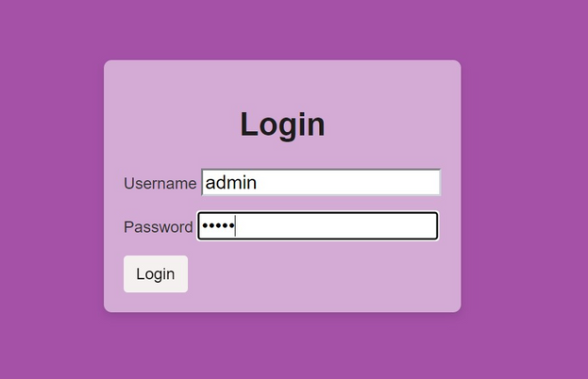

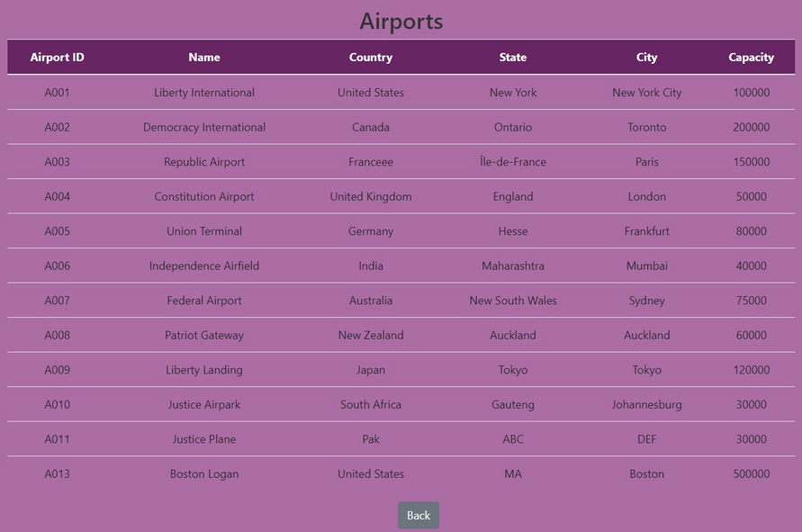
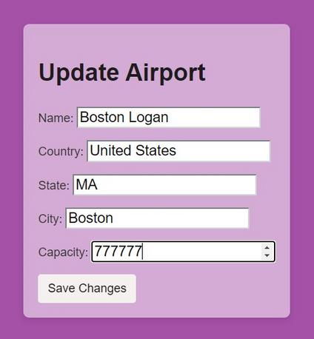
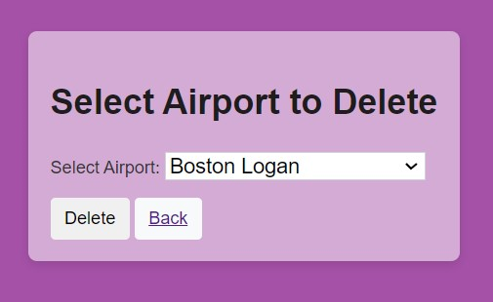
Graphical User INTERFACE

